Slide 1
OSPF
Course Code: CSC 3116
Course Title: Computer Networks
Dept. of Computer Science
Faculty of Science and Technology
Lecturer No: | Lab 8 | Week No: | 10 | Semester: | Summer 22-23
Lecturer: | Md. Faruk Abdullah Al Sohan; faruk.sohan@aiub.edu

Slide 2
Lecture Outline
OSPF Theory
OSPF Configuration

Slide 3
Topic Heading..
Topic sub heading..
 | EIGRP | OSPF
1 | It supports maximum 255 routers in the network. However, the default is 100 routers. (highly scalable) | Supports unlimited number of routers
2 | Fast convergence due to feasible successor | Fastest convergence speed due to the area concept
3 | Cisco proprietary protocol and can be implemented only in Cisco routers. | Open standard protocol and can be implement in any router.
4 | It calculates the metric In terms of bandwidth and delay (default). | It calculates the metric In terms of bandwidth only.
5 | EIGRP works on DUAL(Diffusing Update Algorithm) Algorithm. | EIGRP works on Dijkstra Algorithm.
6 | It maintains the best route and some other alternative routes for each destination. | It maintains the best route in routing table and all routes in database table.
7 | It is basically use for medium to lager size organization in the network [1]. | It is basically use for lager size organization in the network [1].
8 | Administrative distance 90 | Administrative distance 110
9 | Easy to implement | The implementation is complicated

Slide 4
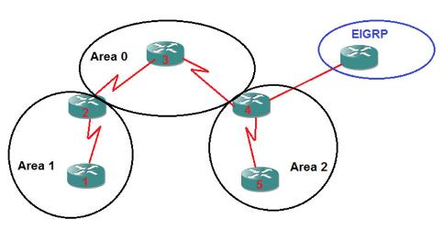
OSPF Theory
OSPF Area
An autonomous system (AS) is
divided into one or more area.
Each area is given an area ID
An AS must have an area having
ID 0 (zero) for multi-area OSPF.
Such area is called backbone area.
All areas of an AS must be
connected to the backbone area.
A router in an area exchanges routing
information with the routers of its
area only (by default)
Autonomous
system 20
Autonomous system 10
Fig. 1 Autonomous systems and area

Slide 5
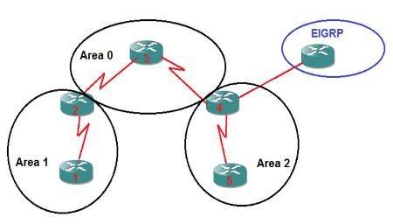
OSPF Theory….
OSPF Routers
Internal Router (IR): The router for which all its interface belong to one area. Router 1 and Router 5.
Area Border Router (ABRs):The router that contains interfaces in more than one area. Router 2 and Router 4
Backbone Router: The router that has all or at least one interface in Area 0. Router 3, Router 2 and Router 4.
Autonomous
system 20
Autonomous system 10
Fig. 1 Autonomous systems and area
Autonomous System Boundary Router (ASBR): The routers with connection to a separate autonomous system. R4 in the example is connected to EIGRP [4].

Slide 6
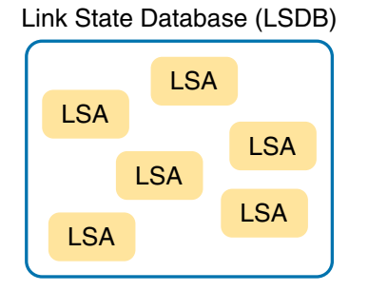
OSPF Theory….
OSPF data structure and packets
Link state advertisement (LSA)
A data structure with some specific information about the networks [2].
Depending on its type, it holds information about
a router’s interfaces,
all routers attached to network,
summary routing information of an area,
all routers of an AS.
Link state database (LSDB)
A collection of all LSAs known to a router
In a convergent network, all routers of a network
have the same LSDB.
Fig. 2 LSA & LSDB relationship

Slide 7
OSPF Theory….
OSPF data structure and packets
Hello
Used to build and maintain neighbor relationships.
DBD – Database Description
List of LSAs contained in a LSDB. This packet type is circulated when two routers are initially exchanging their link-state databases.
Link State Request (LSR)
Used to request complete information about a link learned from another router.
Link State Update (LSU)
Used to send one or LSA(s)
Links State Acknowledgement (LSAck)
Used to acknowledge the reception of an LSA

Slide 8
OSPF Theory….
Neighbor discovery
Parameters need to be identical for two routers to become neighbors
Network mask—net mask of the sending router
Subnet number —derived using the subnet mask and each router’s interface Internet Protocol (IP) address
Area ID—area ID of the sending interface
Hello interval—how often Hello packets are transmitted
Dead interval—how long to wait for Hello packets before terminating neighbor
Authentication type and password—optional
Stub area flag—specifies the type of stub area, if applicable [3]
Hello packet contains all these information

Slide 9
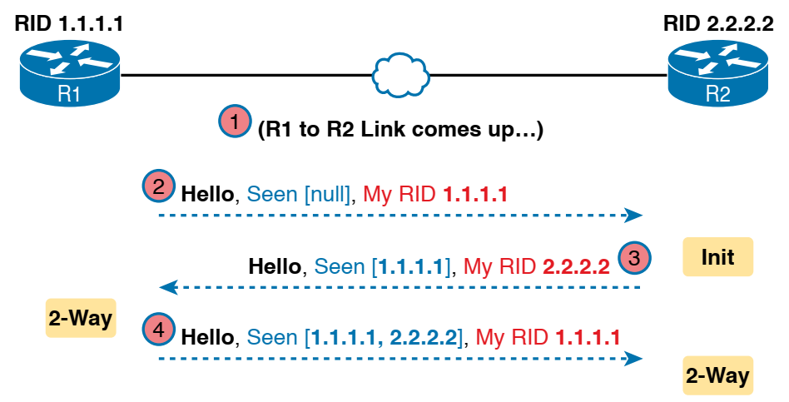
OSPF Theory….
Neighbor discovery….
The scenario begins with the link down, so the routers have no knowledge of each other as OSPF neighbors
Link between R1 and R2 comes up
R1 sends the first Hello to multicast IP address 224. 0.0.5, so R2 learns of the existence of R1 as an OSPF router. At that point, R2 lists R1 as a neighbor, with an interim beginning state of init.
Fig. 3 Neighbor discovery
R2 sends back a Hello which tells R1 that R2 exists, and it allows R1 to move through the init state and quickly to a 2-way state.
R2 receives the next Hello from R1, and R2 can also move to a 2-way state [2]

Slide 10
OSPF Theory….
Router ID
32-bit unique dotted decimal
number
Start
Yes
Manually configured?
Manually configured RID
No
Yes
Loopback interface configured?
RID is the highest IP address
among the loopback interfaces
No
RID is the highest IP address
among the physical interfaces
Stop
Fig. 4 Flow chart of Router ID selection

Slide 11
OSPF Theory….
DR and BDR
Point-to-point network
A network in an area connecting only two routers
directly.
Broadcast network
A network in an area connecting more than two routers
Designated router (DR)
In a broad cast network, a router with the highest priority .
If the priorities tie, the router having the highest RID
All database exchange is done via DR
Backup Designated router (BDR)
In a broad cast network, a router with the second highest priority .
If the priorities tie, the router having the second highest RID
If the DR fails, the BDR takes over.
DROTHER: The router which is neither DR nor BDR [2]

Slide 12
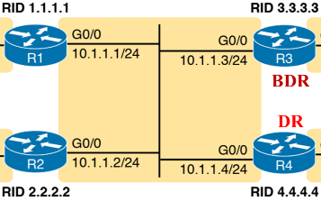
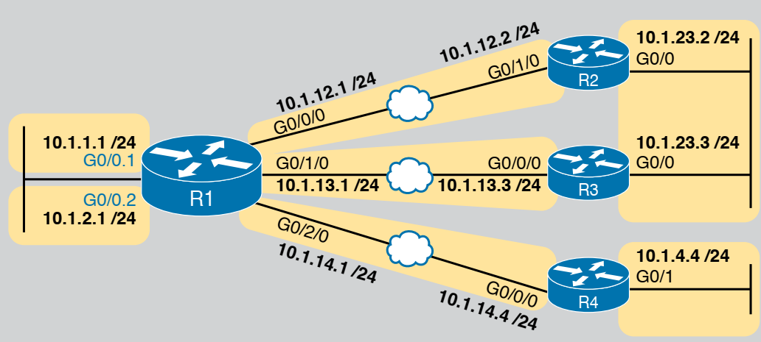
OSPF Theory….
DR and BDR….
Fig. 5 point-to-point network
Fig. 6 Broadcast network , DR and BDR
election

Slide 13
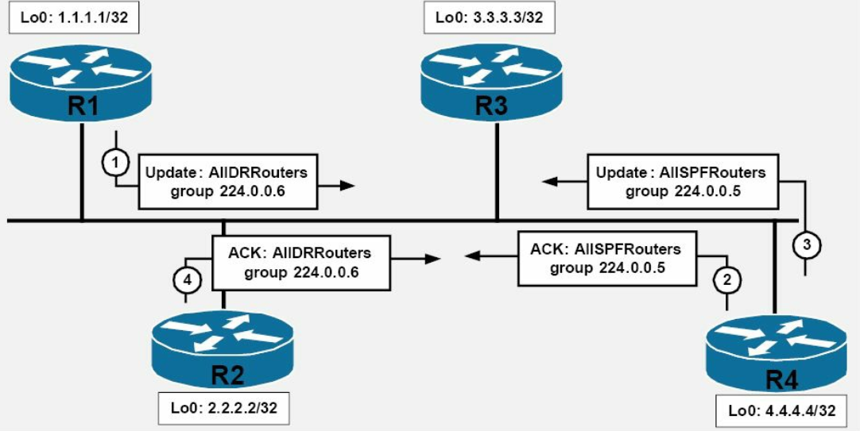
OSPF Theory….
DR and BDR….
Fig. 7 Illustration of update exchange through DR and BDR

Slide 14
Configuration
Wildcard mask
Used to specify a range of network addresses.
Inverted subnet mask
Used in EIGRP, OSPF and Access-List.
How to get wildcard mask of an IP address?
Subtract the subnet mask from 255.255.255.255
What does each bit of a wildcard mask mean?
0 : All IP address in the range must match the bit
1 : Different IP address in the range can have different value in the bit position

Slide 15
Configuration….
Wildcard mask….
Only 192.168.3.0
All bits must match.
WCM: All bits 0. (00000000.00000000.00000000.00000000)
WCM: 0.0.0.0
IP address range: 192.168.3.0 to 192.168.3.255
Match first three block (24 bits) and fourth block can take any value
WCM: 0.0.0.255
IP address range: 192.168.3.4 to 192.168.3.13
First 28 bits same.
Match first 28 bits; make them all zero
Make rest of the bits 1
11000000.10101000.00000011.00000100
11000000.10101000.00000011.00001101
00000000.0000000.00000000.00001111
WCM: 0.0.0.15
Actual IP range: 192.168.3.0 to 192.168.3.15 under WCM: 0.0.0.15

Slide 16

Configuration….
Commands
Network: 172.16.1.0/30
Network: 192.168.2.0/24
Network: 172.16.1.4/30
The prefix 30 means subnet mask: 255.255.255.252
Wildcard mask: 0.0.0.3
Prefix 24 indicates subnet mask: 255.255.255.0
Wildcard mask: 0.0.0.255
OSPF Configuration
R1(config)# router ospf process_id
R1(config-router)#network network_IP WCM area area_id
Process ID is an integer. Not all routers need to have the same process ID.

Slide 17
Configuration….
Commands….
Network: 172.16.1.0/30
Network: 192.168.2.0/24
Network: 172.16.1.4/30
The prefix 30 means subnet mask: 255.255.255.252
Wildcard mask: 0.0.0.3
Prefix 24 indicates subnet mask: 255.255.255.0
Wildcard mask: 0.0.0.255
R1(config)# router ospf 10
R1(config)# router –id 1.1.1.1
R1(config-router)#network 192.168.2.0 0.0.0.255 area 0
R1(config-router)#network 172.16.1.0 0.0.0.3 area 0
R1(config-router)#network 172.16.1.4 0.0.0.3 area 0

Slide 18
Configuration….
Commands….
Network: 172.16.1.0/30
Network: 192.168.2.0/24
Network: 172.16.1.4/30
R1(config)# router ospf 10
R1(config-router)#network 192.168.2.0 0.0.0.255 area 0
R1(config-router)#network 172.16.1.0 0.0.0.255 area 0
ospf protocol will be used in any network of area 0 which is
connected to the router, having network IP address with first three
octets 172.16.1 [2]

Slide 19
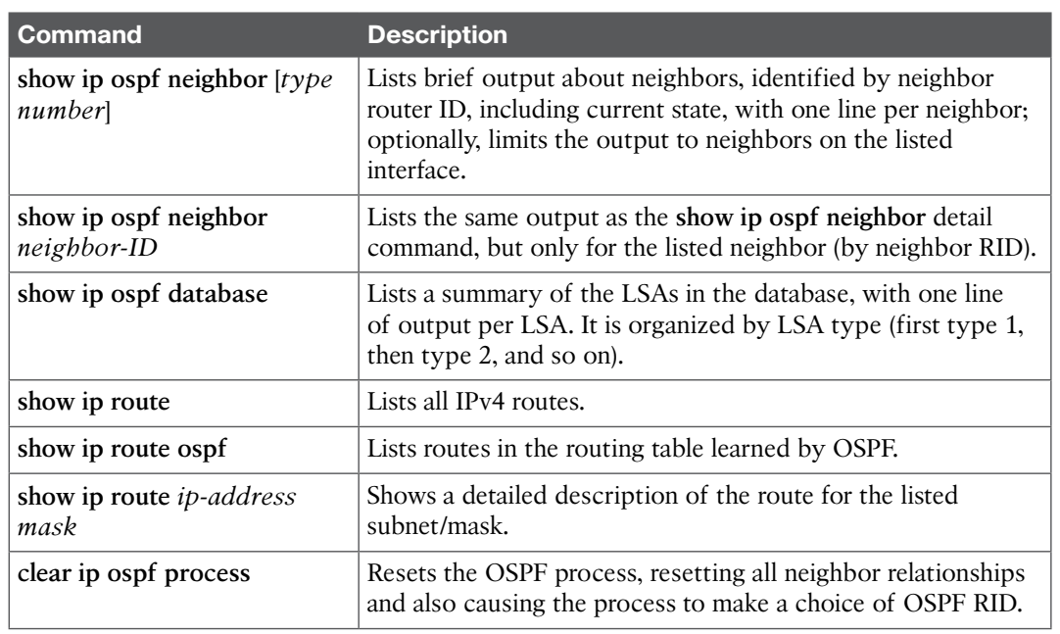
Topic Heading..
Commands….
TABLE II Command for verifying configuration [2]

Slide 20
References
[1] Computer Networking Class, https://computernetworkingclass.blogspot.com...
/2016/08/comparison-between-rip-eigrp-igrp-and.html, [Accessed: May 2, 2020].
[2] W. Odom, Official Cert Gudie CCNA 200-301 Volume 1, Pearson Education, Inc., USA, 2020,
pp. 449-497.
[3] J. Macfarlane, Network Routing Basics, Wiley Publications. Inc., USA, 2006, pp. 254.
[4] OSPF, “http://www.certiology.com/cisco-certifications/ccna/ccna-routing-and-switching/free-cisco-ccna-study-guide/ospf.html, [Accessed: May 2, 2020]..

Slide 21
Books
1. Official Cert Guide CCNA 200-301 , vol. 1, W. Odom, Cisco Press, First Edition, 2019, USA.
2. CCNA Routing and Switching, T. Lammle, John Wily & Sons, Second Edition, 2016, USA.

